Slide 1

PRESENTATION ON SIMULATION AND VERIFICATION OF GRID CONVERTER CONTROLLED DFIG WIND TURBINE MODEL
PRESENTED BY
PROJECT MENTOR :PROF. SUVOBRATA SIL
PROJECT MEMBERS:
RITESH KUMAR SINHA(12617016034)
KALLOL GHOSH(12617016020)
AYUS SUKLA(12617016012)
SAIRATH DAS(12617016038)
SAUVIK SARKAR(12617016044)
SAYANDIP PAUL(12617006039)
Department of Electrical Engineering
Heritage Institute of Technology
Chowbaga Road, Anandapur, Kolkata-700107
Year – 2017-2021

Slide 2
CONTENTS
Introduction & Needs of Renewable Resources
Wind Power Conversion
Basic Control Variables for Wind Turbines
Various Types of Wind Turbines
Supply Configuration of Doubly Fed Induction Machine (DFIM)
Turbine Control Zones
Power Converters for Wind Turbines
Power Semi-Conductors for Wind Power Converter
Controls and Grid Requirements for Modern Wind Turbines & Active Power Control
Reactive Power Control & Total Harmonic Distortion
MATLAB Simulation – Implementation and Control of Doubly Fed Induction Machine
MATLAB Simulation – Implementation of Simple Wind Turbine Model Using Doubly Fed Induction Generator (DFIG)
MATLAB Simulation - On Grid Converter Implementation in Wind Turbine on DFIG
Emerging Reliability Issues for Wind Power System
Conclusion
Reference

Slide 3
INTRODUCTION [1]
Wind power is still the most promising renewable energy source because it has relatively low energy cost. The wind turbine system (WTS) technology started with a few tens of kilowatts of power in the 1980s, whereas nowadays, multi-megawatt (MW) wind turbines are generally installed and their size is still growing.
NEEDS OF RENEWABLE RESOURCES [1]
Renewable energy is the energy which comes from natural resources such as sunlight, wind, rain, tides and geothermal heat. These resources are renewable and can be naturally replenished. Therefore, for all practical purposes, these resources can be considered to be inexhaustible, unlike dwindling conventional fossil fuels. Renewable energy sources are hygienic sources of energy that have a much lesser negative environmental impact than conventional fossil energy technologies.
[1] Haitham Abu-Rub, Mariusz Malinowski, Kamal Al-Haddad, POWER ELECTRONICS FOR RENEWABLE ENERGY SYSTEMS, TRANSPORTATION AND INDUSTRIALAPPLICATIONS © 2014 John Wiley & Sons Ltd, ISBN 978-1-118-63403-5

Slide 4
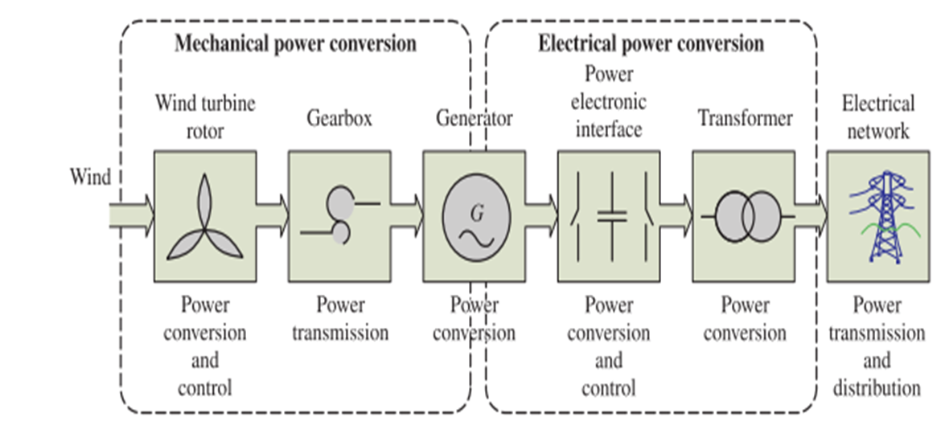
WIND POWER CONVERSION [1]
[1] Haitham Abu-Rub, Mariusz Malinowski, Kamal Al-Haddad, POWER ELECTRONICS FOR RENEWABLE ENERGY SYSTEMS, TRANSPORTATION AND INDUSTRIALAPPLICATIONS © 2014 John Wiley & Sons Ltd, ISBN 978-1-118-63403-5

Slide 5
BASIC CONTROL VARIABLES FOR WIND TURBINES [1]
For a WTS, it is essential to be able to limit the mechanical power generated by the turbines under
higher wind speeds in order to prevent overloading.
1.Passive Stall control - Blade position is fixed but stall of the wind appears along the blade.
2.Active Stall control - blade angle is adjusted in order to create stall along the blade.
3.Pitch control - Blades are turned out of the wind.
[1] Haitham Abu-Rub, Mariusz Malinowski, Kamal Al-Haddad, POWER ELECTRONICS FOR RENEWABLE ENERGY SYSTEMS, TRANSPORTATION AND INDUSTRIALAPPLICATIONS © 2014 John Wiley & Sons Ltd, ISBN 978-1-118-63403-5

Slide 6
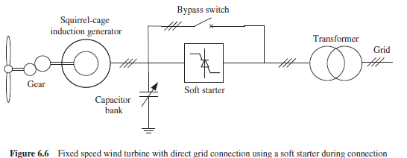
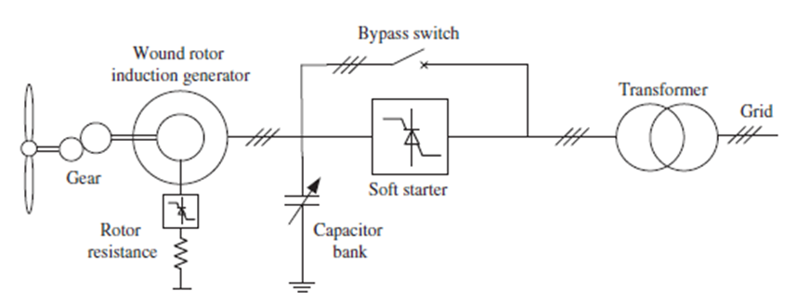
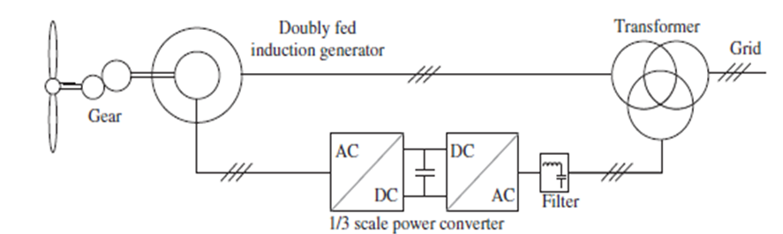
VARIOUS TYPES OF WIND TURBINE [1]
Fixed Speed Wind Turbines (WT Type A) - The wind turbine is equipped with an asynchronous SCIG and smoother grid connection can be achieved by incorporating a soft starter, which is bypassed during the normal generation mode.
Partial Variable Speed Wind Turbine with Variable Rotor Resistance (WT Type B) This concept is also known as Opti-Slip . It introduces the variable rotor resistance and, thus, limits the speed controllability of wind turbines.
Variable Speed WT with Partial-Scale Frequency Converter (WT Type C) A back-to-back power electronic converter is adopted in conjunction with a DFIG ( Doubly Fed Induction Generator
Variable Speed Wind Turbine with Full-Scale Power Converter (WT Type D) - It introduces a full-scale power converter to interconnect the power grid and stator windings of the generator; thus, all the power generated by the wind turbine can be regulated.
(WT Type A)
(WT Type B)
(WT Type C)
[1] Haitham Abu-Rub, Mariusz Malinowski, Kamal Al-Haddad, POWER ELECTRONICS FOR RENEWABLE ENERGY SYSTEMS, TRANSPORTATION AND INDUSTRIALAPPLICATIONS © 2014 John Wiley & Sons Ltd, ISBN 978-1-118-63403-5

Slide 7
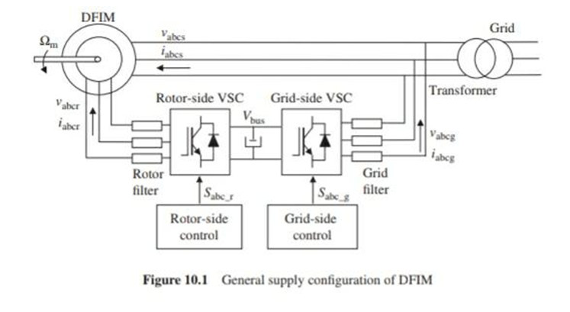

SUPPLY CONFIGURATION OF DFIM [2]
DFIM-BASED WIND ENERGY CONVERSION SYSTEMS
Wind Turbine Aerodynamic
This section analyzes the most important issues of DFIM-based pitch-regulated variable-speed wind turbines. In this type of modern wind turbine, the energy from the wind is captured mechanically by the blades, then it is converted to electric energy by the DFIM, and finally, this energy is delivered to the electricity network . Under certain ideal assumptions, the wind turbine can recover the power from wind given by the expression:
Where ρ is the air density, R is the radius of the blades of the wind turbine, Vw is the wind speed and Cp is The power coefficient; a dimensionless parameter that expresses the effectiveness of the wind turbine in the transformation of the kinetic energy of the wind into mechanical energy.
$P_{t}=\frac{1}{2}$π$R^{2}\text{ρ}{V_{W}}^{3}C_{P}$
[2] Gonzalo Abad , Jesu´s Lo´pez , Miguel A. , Rodrı´guez , Luis Marroyo , Grzegorz Iwanski, DOUBLY FED INDUCTION MACHINE MODELING AND CONTROL FOR WIND ENERGY GENERATION © 2011 John Wiley & Sons Ltd, ISBN 978-0-470-76865-5

Slide 8
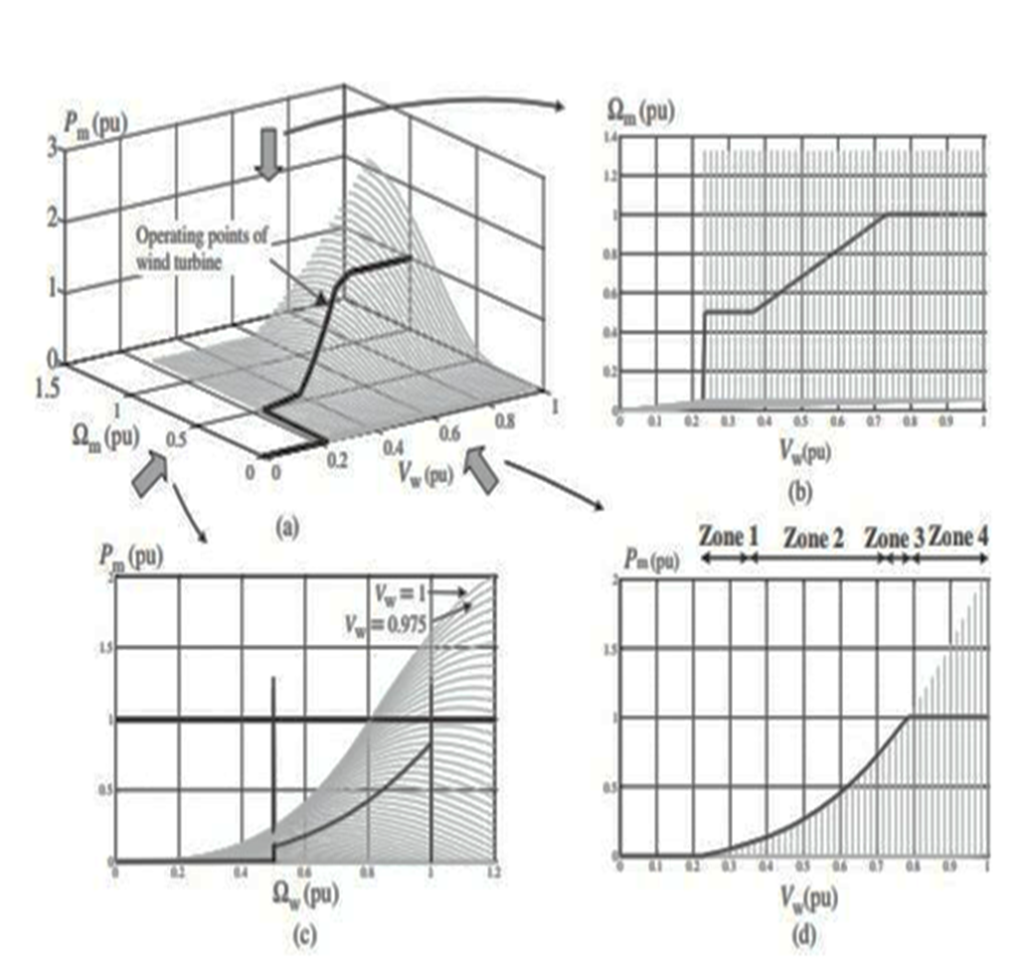
TURBINE CONTROL ZONES [1]
Zone 1:
Zone 2:
Zone 3:
Zone 4:
[1] Haitham Abu-Rub, Mariusz Malinowski, Kamal Al-Haddad, POWER ELECTRONICS FOR RENEWABLE ENERGY SYSTEMS, TRANSPORTATION AND INDUSTRIALAPPLICATIONS © 2014 John Wiley & Sons Ltd, ISBN 978-1-118-63403-5

Slide 9
POWER CONVERTERS FOR WIND TURBINES [1]
Because of the rapid development of capacity and technology in wind power generation, the power electronic converter is becoming an increasingly important part of the entire system, as indicated in Figure
Two-Level Power Converter
Two-Level Unidirectional Voltage Source Power Converter (2L-UNI)
Two-Level Back-To-Back Voltage Source Power Converter (2L-BTB)
Multilevel Power Converter
Three-Level Neutral-Point Diode Clamped Back-To-Back Topology (3L-NPC BTB)
Three-Level H-Bridge Back-To-Back Topology (3L-HB BTB)
Five-Level H-Bridge Back-To-Back Topology (5L-HB BTB)
[1] Haitham Abu-Rub, Mariusz Malinowski, Kamal Al-Haddad, POWER ELECTRONICS FOR RENEWABLE ENERGY SYSTEMS, TRANSPORTATION AND INDUSTRIALAPPLICATIONS © 2014 John Wiley & Sons Ltd, ISBN 978-1-118-63403-5

Slide 10
POWER SEMICONDUCTORS FOR WIND POWER CONVERTER [1]
The dominant choices for power switching devices, as reported in the wind power industry, are based on the module packaging insulated gate bipolar transistor (IGBT), the presspack packaging IGBT and the presspack packaging integrated gate-commutated thyristor (IGCT).
Owing to the soldering and bond wire connections of the internal chips, module packaging devices might suffer from larger thermal resistance, lower power density and higher failure rates .
The presspack packaging technology improves the connection of the chips by direct presspack contacting, which leads to improved reliability (known from industrial experience), higher power density (easier stacking for connection) and better cooling capability.
[1] Haitham Abu-Rub, Mariusz Malinowski, Kamal Al-Haddad, POWER ELECTRONICS FOR RENEWABLE ENERGY SYSTEMS, TRANSPORTATION AND INDUSTRIALAPPLICATIONS © 2014 John Wiley & Sons Ltd, ISBN 978-1-118-63403-5

Slide 11
CONTROLS AND GRID REQUIREMENTS FOR MODERN WIND TURBINES [1]
Controlling a wind turbine involves both fast and slow control dynamics.
ACTIVE POWER CONTROL [1]
According to most grid codes, individual wind turbines must be able to control the active power in the point-of-common coupling (PCC) within a given power range. Typically, the active power is controlled based on the system frequency
For larger generation units on the wind farm scale, which are normally connected at the transmission line, the wind turbines should act as conventional power plants providing a wide range of controlled active power based on the demands of the TSO.
[1] Haitham Abu-Rub, Mariusz Malinowski, Kamal Al-Haddad, POWER ELECTRONICS FOR RENEWABLE ENERGY SYSTEMS, TRANSPORTATION AND INDUSTRIALAPPLICATIONS © 2014 John Wiley & Sons Ltd, ISBN 978-1-118-63403-5

Slide 12
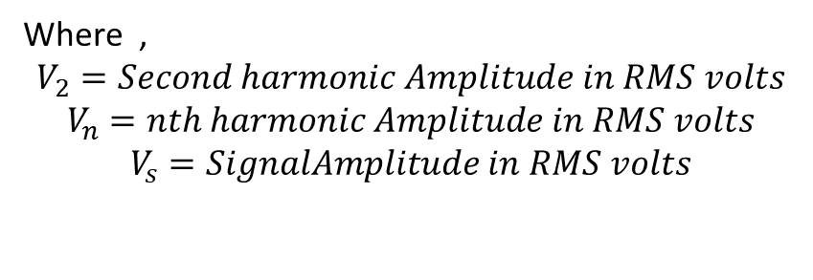

REACTIVE POWER CONTROL [1]
During normal operation, the reactive power delivered by the wind turbine or wind farm also has to be regulated by the grid codes within a certain range.
TOTAL HARMONIC DISTORTION [1]
$$THD=\frac{\sqrt{{V_{2}}^{2}+{V_{3}}^{2}+…+{V_{n}}^{2}}}{V_{S}}$$
Where ,
$$V_{2}=Second harmonic Amplitude in RMS volts$$
$$V_{n}=nth harmonic Amplitude in RMS volts$$
$$V_{s}=SignalAmplitude in RMS volts$$
[1] Haitham Abu-Rub, Mariusz Malinowski, Kamal Al-Haddad, POWER ELECTRONICS FOR RENEWABLE ENERGY SYSTEMS, TRANSPORTATION AND INDUSTRIALAPPLICATIONS © 2014 John Wiley & Sons Ltd, ISBN 978-1-118-63403-5

Slide 13
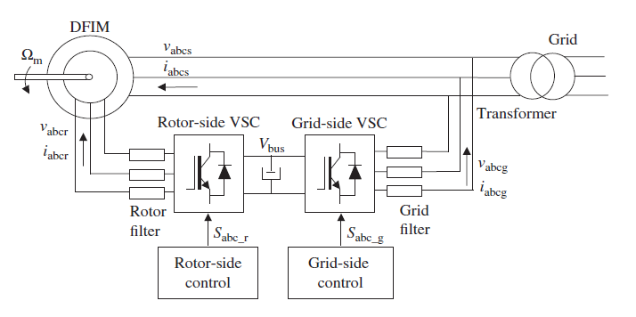
1. MATLAB SIMULATION – IMPLEMENTATION AND CONTROL OF DOUBLY FED INDUCTION MACHINE [1]
[1] Haitham Abu-Rub, Mariusz Malinowski, Kamal Al-Haddad, POWER ELECTRONICS FOR RENEWABLE ENERGY SYSTEMS, TRANSPORTATION AND INDUSTRIALAPPLICATIONS © 2014 John Wiley & Sons Ltd, ISBN 978-1-118-63403-5

Slide 14
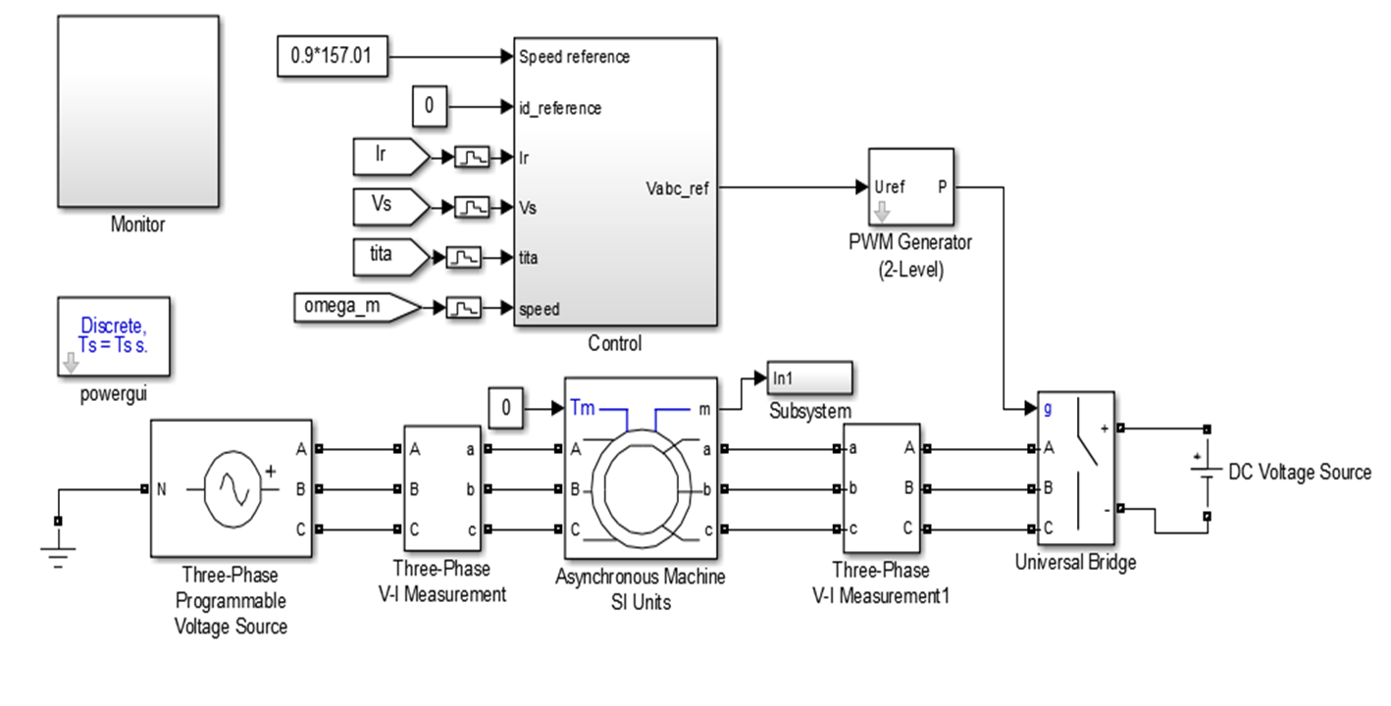
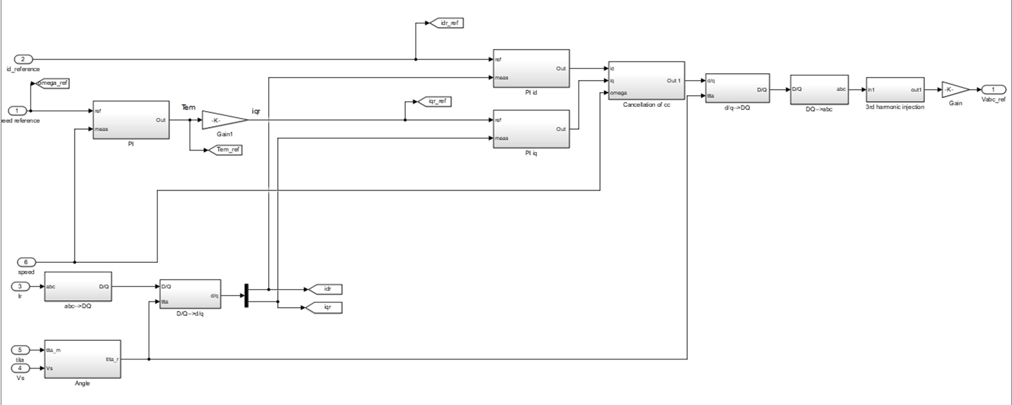

Slide 15
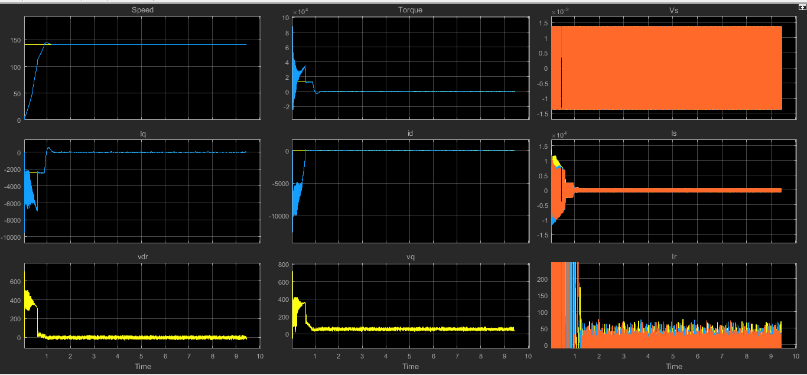
AT NO LOAD AND 90% OF SYNCHRONOUS SPEED
The machine acts like a motor.
The speed is increasing slowly and slowly to the 90% steady state synchronous speed.
A strong perturbation in torque is present at the transient state, but at steady state it stays at zero since operated at no load.
The Vs, Is, Ir all are sinusoidal in nature.
An initial disturbance is present in the iq and id but at steady state it stays at zero.
An initial disturbance is present in the vdr and vq but at steady state vdr stays at zero but vq takes a non zero value.

Slide 16
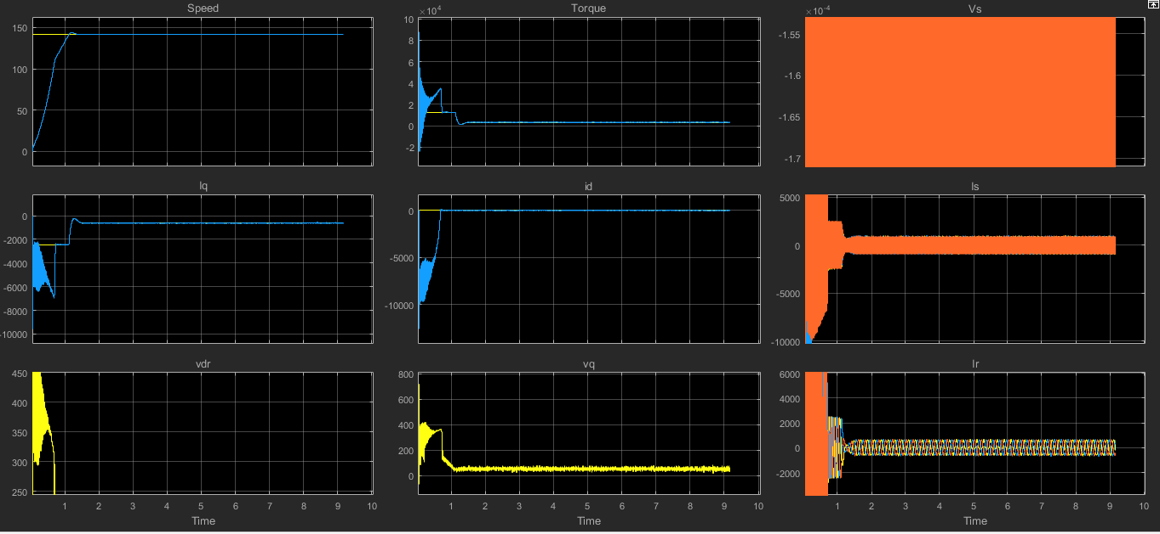
AT 25% OF RATED LOAD AND 90% OF SYNCHRONOUS SPEED
The machine here acts like a motor.
The speed is increasing slowly and slowly to the 90% steady state synchronous speed.
A strong perturbation in torque is present at the transient state, but at steady state it stays at non-zero value since it is operated at 25% load.
The Vs, Is, Ir all are sinusoidal in nature.
An initial disturbance is present in the iq and id but at steady state id stays at zero and iq takes neagative non zero value.
An initial disturbance is present in the vdr and vq but at steady state vdr and vq both occupies a non zero value.

Slide 17
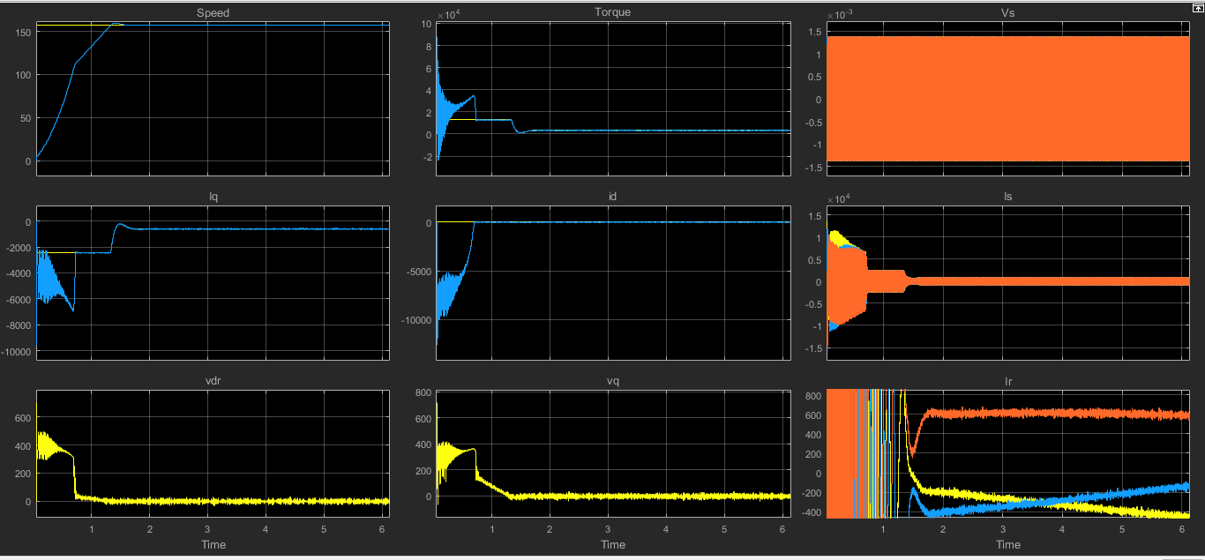
AT 25% OF RATED LOAD AND 100% OF SYNCHRONOUS SPEED THE MACHINE ACTS AS DFI MOTOR
The machine here acts like a motor.
The speed is increasing slowly and slowly to the 100% steady state synchronous speed.
A strong perturbation in torque is present at the transient state, but at steady state it stays at non-zero value since it is operated at 25% load.
The Vs, Is, Ir all are sinusoidal in nature, but at steady state Ir becomes almost DC and is not sinusoidal anymore.
An initial disturbance is present in the iq and id but at steady state id stays at zero and iq takes negative non zero value.
An initial disturbance is present in the vdr and vq but at steady state vdr and vq both occupies zero value.

Slide 18
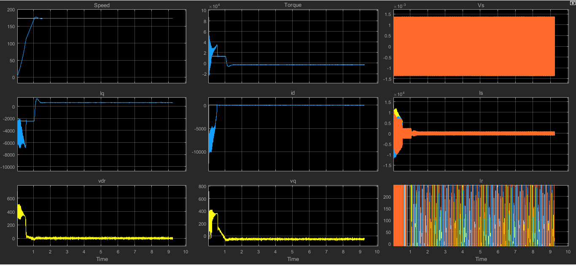
AT -25% OF RATED LOAD AND 110% OF SYNCHRONOUS SPEED
The machine here acts like a generator. The load torque is negative for generator operation .
The speed is increasing slowly and slowly to the 110% steady state synchronous speed.
A strong perturbation in torque is present at the transient state, but at steady state it stays at negative non-zero value since it is operated at
-25% of rated load.
The Vs, Is, Ir all are sinusoidal in nature at steady state.
An initial disturbance is present in the iq and id but at steady state id stays at zero and iq takes positive non zero value.
An initial disturbance is present in the vdr and vq but at steady state vdr occupies zero value and vq takes a negative nonzero value.

Slide 19
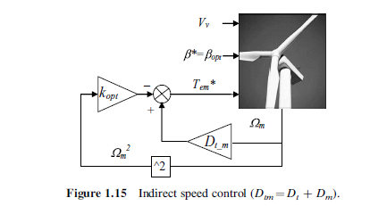
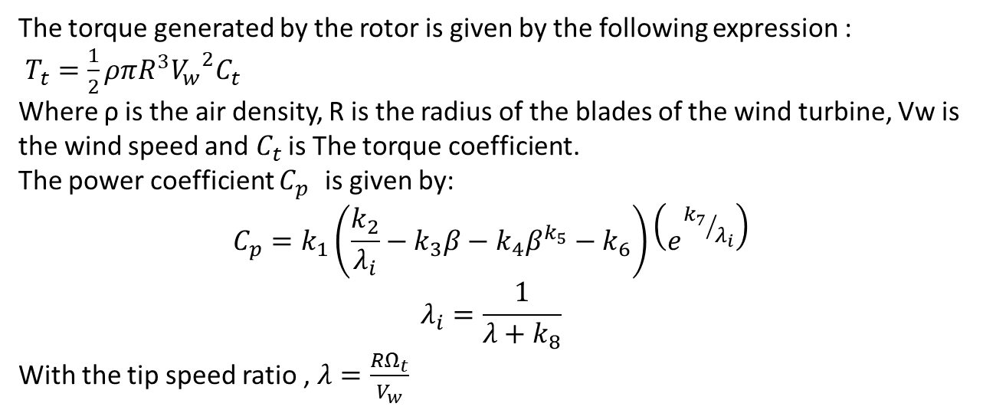
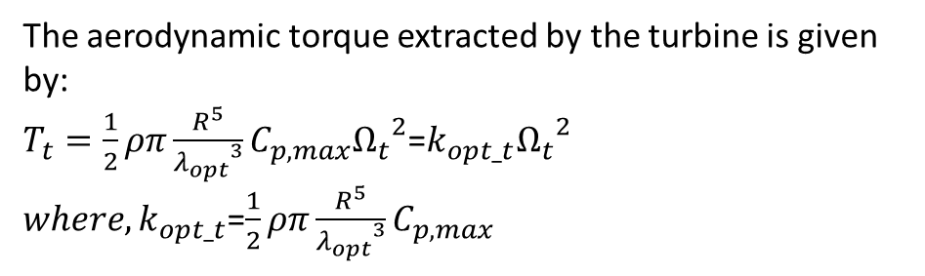
2. MATLAB SIMULATION – IMPLEMENTATION OF SIMPLE WIND TURBINE MODEL USING DFIG
MPPT STRATEGY
The torque generated by the rotor is given by the following expression :
$T_{t}=\frac{1}{2}ρπR^{3}{V_{w}}^{2}C_{t}$
Where ρ is the air density, R is the radius of the blades of the wind turbine, Vw is the wind speed and $C_{t}$ is The torque coefficient.
The power coefficient $C_{p }$ is given by:
$$C_{p}=k_{1}\left(\frac{k_{2}}{λ_{i}}−k_{3}β−k_{4}β^{k_{5}}−k_{6}\right)\left(e^{{k_{7}}/{λ_{i}}}\right)$$
$$λ_{i}=\frac{1}{λ+k_{8}}$$
With the tip speed ratio , $λ=\frac{RΩ_{t}}{V_{w}}$
The aerodynamic torque extracted by the turbine is given by:
$T_{t}=\frac{1}{2}ρπ\frac{R^{5}}{{λ_{opt}}^{3}}C_{p,max}{Ω_{t}}^{2}$=$k_{opt_t}{Ω_{t}}^{2}$
${where, k}_{opt_t}$=$\frac{1}{2}ρπ\frac{R^{5}}{{λ_{opt}}^{3}}C_{p,max}$
[1] Haitham Abu-Rub, Mariusz Malinowski, Kamal Al-Haddad, POWER ELECTRONICS FOR RENEWABLE ENERGY SYSTEMS, TRANSPORTATION AND INDUSTRIALAPPLICATIONS © 2014 John Wiley & Sons Ltd, ISBN 978-1-118-63403-5

Slide 20
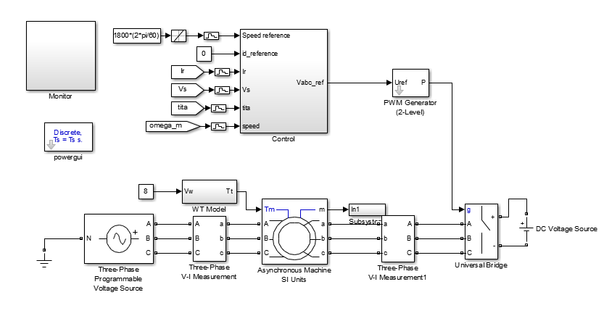
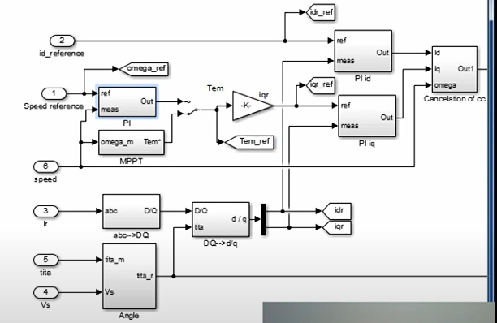
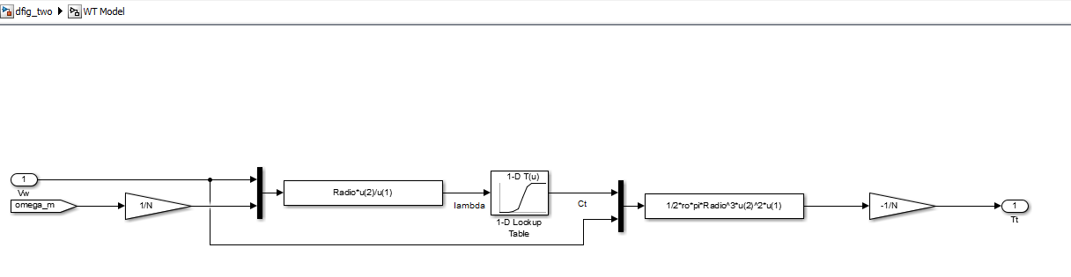
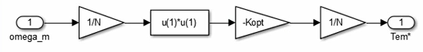
CONTROL STRATEGY
WT MODEL
MPPT STRATEGY

Slide 21
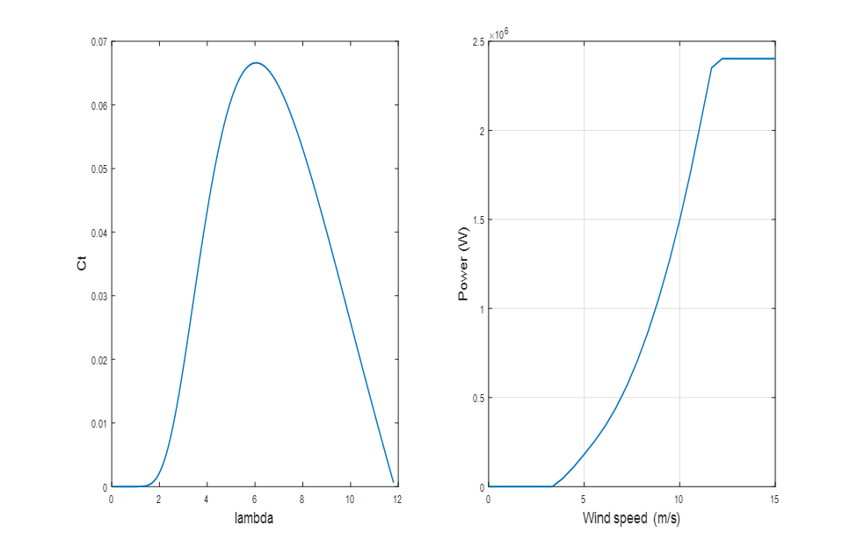
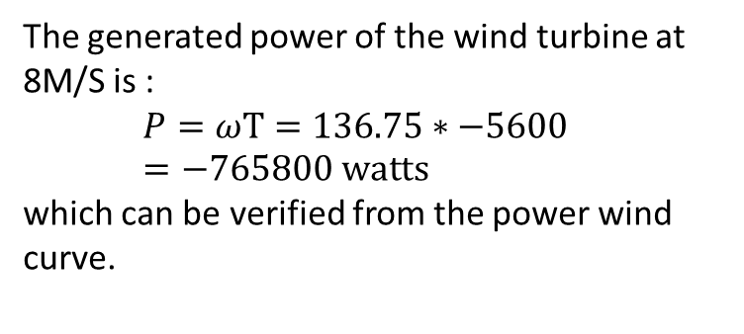
The generated power of the wind turbine at 8M/S is :
$$P=ωΤ=136.75∗−5600 =−765800 watts$$
which can be verified from the power wind curve.
The generated power of the wind turbine at 10M/S is :
𝑃 =𝜔Τ = 171.25∗−8700
=−1489875 watts
which can be verified from the power wind curve.

Slide 22
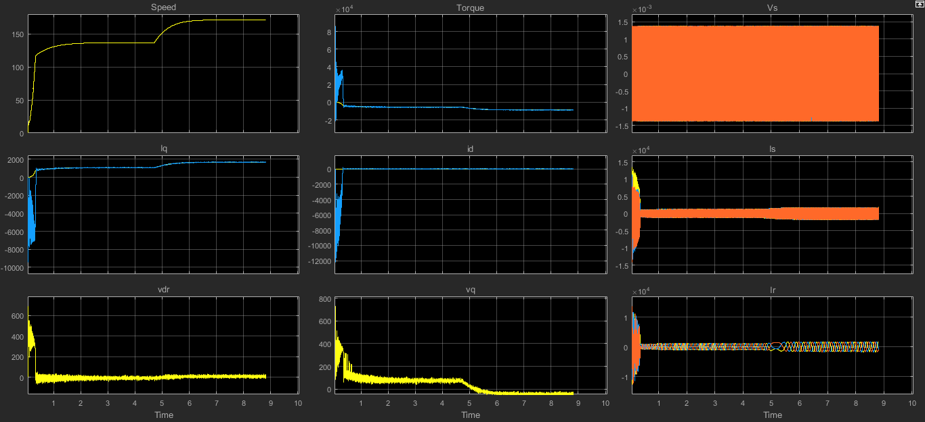
MATLAB SIMULATION AT WIND SPEED = 8M/S AND AT WIND SPEED = 10M/S
The machine here is operated as a generator.
The speed is increasing slowly and slowly to the steady state at 8M/S and then again speed increases when the wind speed increases to 10M/S and reaches a steady state speed beyond the synchronous speed .
A strong perturbation in torque is present at the transient state, but at steady state it stays at negative non-zero value at both wind speed = 8m/s and at wind speed = 10m/s .
The Vs, Is, Ir all are sinusoidal in nature at steady state.
An initial disturbance is present in the iq and id but at steady state id stays at zero and iq takes positive non zero value at both wind speed = 8m/s and at wind speed = 10m/s .
An initial disturbance is present in the vdr and vq but at steady state vdr occupies zero value and vq takes a positive non zero value at wind speed = 8m/s and a negative non zero value at wind -
speed = 10m/s .

Slide 23
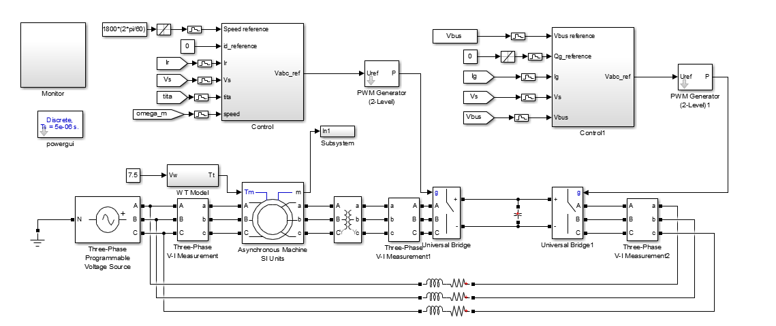
3. MATLAB SIMULATION ON GRID CONVERTER IMPLEMENTATION IN WIND TURBINE ON DFIG

Slide 24
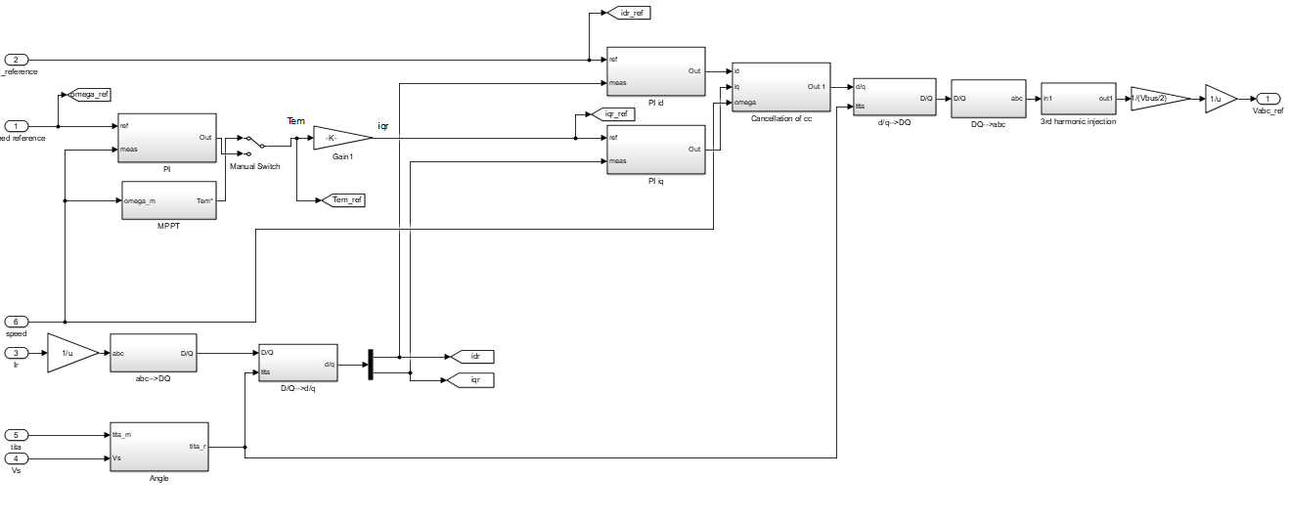
INSIDE THE CONTROL CIRCUIT BLOCK

Slide 25
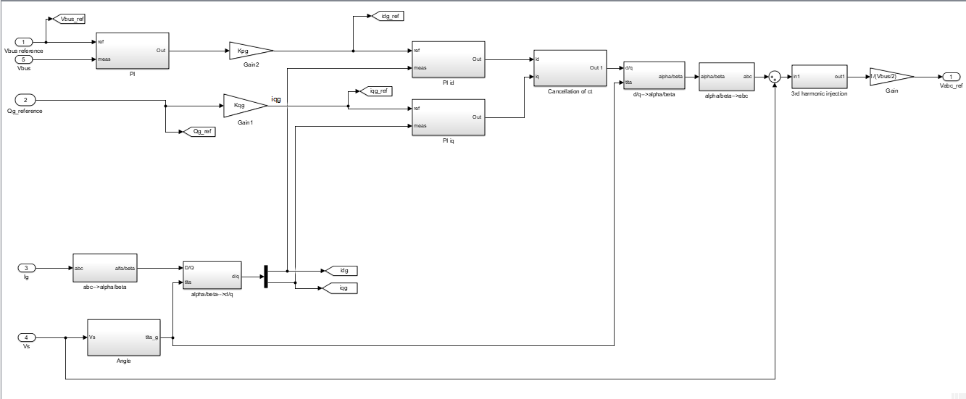
INSIDE THE CONTROL CIRCUIT1 BLOCK

Slide 26
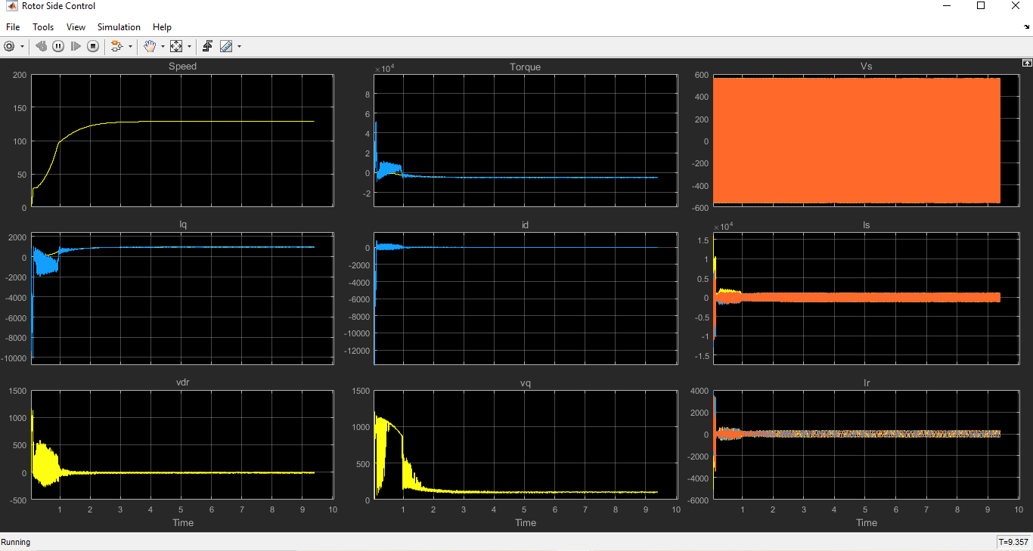
MATLAB SIMULATION AT WIND SPEED = 7.5 M/S FOR ROTOR SIDE CONTROL
The machine here is operated as a generator.
The speed is increasing slowly and slowly to the steady state at 7.5M/S wind speed.
A strong perturbation in torque is present at the transient state, but at steady state it stays at negative non-zero value.
The Vs, Is, Ir all are sinusoidal in nature at steady state.
An initial disturbance is present in the iq and id but at steady state id stays at zero and iq takes positive non zero value.
An initial disturbance is present in the vdr and vq but at steady state vdr occupies zero value and vq takes a positive non zero value.

Slide 27
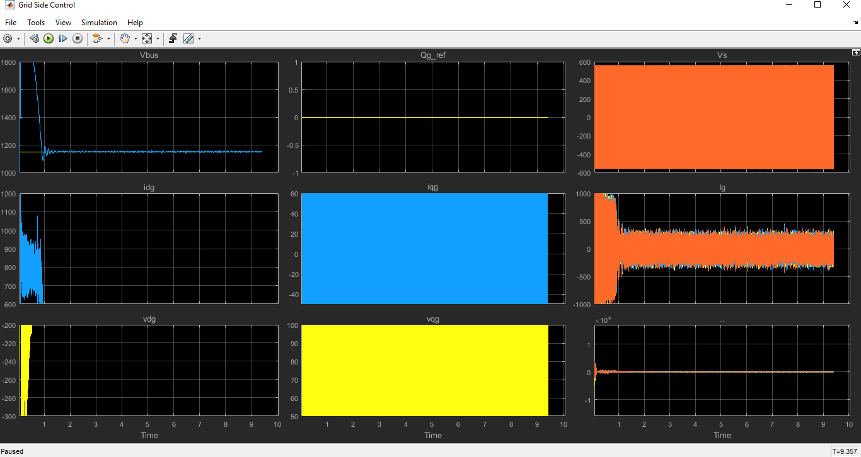
MATLAB SIMULATION AT WIND SPEED = 7.5 M/S FOR GRID SIDE CONTROL
The machine here is operated as a generator.
There is a large overshoot in the DC bus voltage since the start-up we he done is very strong.
The reference reactive power stays at zero.
The Vs, Is, Ir all are sinusoidal in nature at steady state.
An initial disturbance is present in the iqg and idg.
An initial disturbance is present in the vdg and vqg.

Slide 28
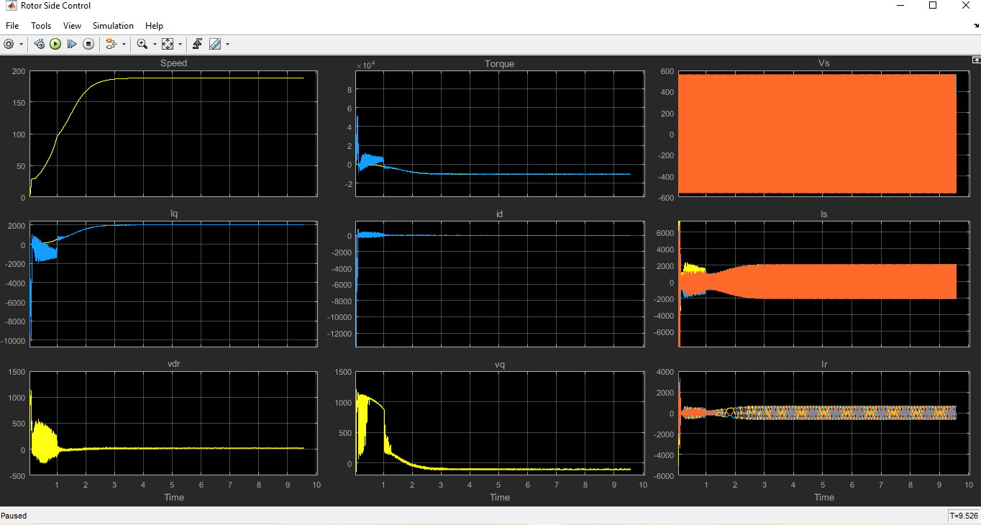
MATLAB SIMULATION AT WIND SPEED = 11M/S AND OG_REF FROM 0 TO -400VA FOR ROTOR SIDE CONTROL
The machine here is operated as a generator.
The speed is increasing slowly and slowly to the steady state at 11M/S wind speed.
A strong perturbation in torque is present at the transient state, but at steady state it stays at negative non-zero value.
The Vs, Is, Ir all are sinusoidal in nature at steady state.
An initial disturbance is present in the iq and id but at steady state id stays at zero and iq takes positive non zero value.
The rotor side currents are almost constant at hyper synchronous speed.
An initial disturbance is present in the vdr and vq but at steady state vdr occupies zero value and vq takes a negative non zero value.

Slide 29
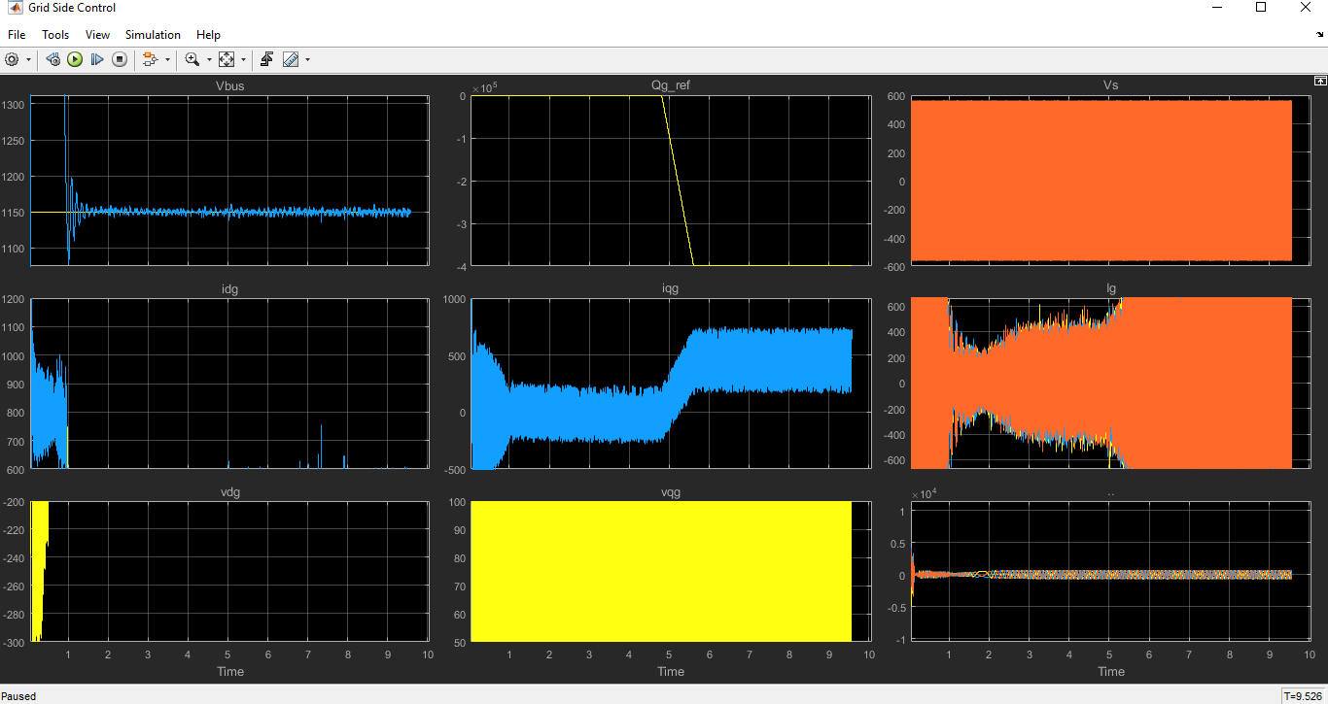
MATLAB SIMULATION AT WIND SPEED = 11M/S AND OG_REF FROM 0 TO - 400VA FOR GRID SIDE CONTROL
The machine here is operated as a generator.
There is a strong perturbance present in the DC bus
voltage and at steady state it stays at 1150 volts.
The reference reactive power stays at -400 at steady
state.
The Vs, Is, Ir all are sinusoidal in nature at steady state.
For the given reactive power the iqg current is being modified.
An initial disturbance is present in the vdg and vqg

Slide 30
EMERGING RELIABILITY ISSUES FOR WIND POWER SYSTEM[1]
The dramatic growth in the total number of installations and of the individual capacity of wind turbines makes their failure harmful or even unacceptable from the TSO point of view. Failures of WTSs will not only cause stability problems for the power grid owing to the sudden absence of large amounts of power, but also result in very high costs for repair and maintenance, especially for those turbines that are large and remote. Therefore, reliability performance is a critical design consideration for the next generation of wind power converter systems.
Unfortunately, former field feedback has shown that the larger wind turbines seem more prone to failure
It is noted that although the generator and gearbox have the largest downtime (i.e., time needed for repair), their probability of failure is lower than that of the electrical and control parts.
In order to achieve more cost-efficient and reliable power electronics, multidiscipline are necessary, which involve stress analysis, strength modelling, statistical considerations and also the online monitoring/control/maintenance of the converter system.
[1] Haitham Abu-Rub, Mariusz Malinowski, Kamal Al-Haddad, POWER ELECTRONICS FOR RENEWABLE ENERGY SYSTEMS, TRANSPORTATION AND INDUSTRIALAPPLICATIONS © 2014 John Wiley & Sons Ltd, ISBN 978-1-118-63403-5

Slide 31
CONCLUSION
This presentation discusses the power electronics used in WTSs. The configurations and roles of power electronics in various wind turbine concepts are illustrated showing that the wind turbine behavior/ performance is significantly improved by introducing power electronics. It is possible for wind turbines to act as an active contributor to the frequency and voltage control in the grid system by means of power control using power electronic converters.
As the WTS capacity and voltage are increasing, a trend is to use multilevel topologies or parallel the converter cells in the wind power converter, and a number of these are shown in this presentation. Different layers of control are discussed, as are the state-of-the-art requirements by grid codes. Finally, the emerging challenges regarding reliability and the approaches for more reliable wind power converters are also highlighted.

Slide 32
REFERENCES
[1] Haitham Abu-Rub, Mariusz Malinowski, Kamal Al-Haddad, POWER ELECTRONICS FOR RENEWABLE ENERGY SYSTEMS, TRANSPORTATION AND INDUSTRIALAPPLICATIONS © 2014 John Wiley & Sons Ltd, ISBN 978-1-118-63403-5
[2] Gonzalo Abad , Jesu´s Lo´pez , Miguel A. , Rodrı´guez , Luis Marroyo , Grzegorz Iwanski, DOUBLY FED INDUCTION MACHINE MODELING AND CONTROL FOR WIND ENERGY GENERATION © 2011 John Wiley & Sons Ltd, ISBN 978-0-470-76865-5

Slide 33
THANK YOU!!
FOR YOUR ATTENTION

